Slide 1
Modern Systems Analysis and Design Fifth Edition
Chapter 2
Initiating and Planning Systems Development Projects
5.1

Slide 2
Learning Objectives
Describe steps involved in the project initiation and planning process (the first two phases of project management)
Explain the need for and the contents of a Statement of Work and Baseline Project Plan
List and describe various methods for accessing project feasibility
5.2

Slide 3
Learning Objectives
Describe the differences between intangible and tangible costs and benefits and between recurring and one-time benefits and costs
Detail various methods of cost/benefit analysis
Describe the general rules for evaluating the technical risks associated with a systems development project
Describe the activities and participant roles within a structured walkthrough
5.3

Slide 4
Initiating and Planning Systems Development Projects
What must be considered when making the decision on the division between project initiation and planning (PIP) and analysis.
How much effort should be expended on the PIP process?
Who is responsible for performing the PIP process?
Why is PIP such a challenging activity?

Slide 5
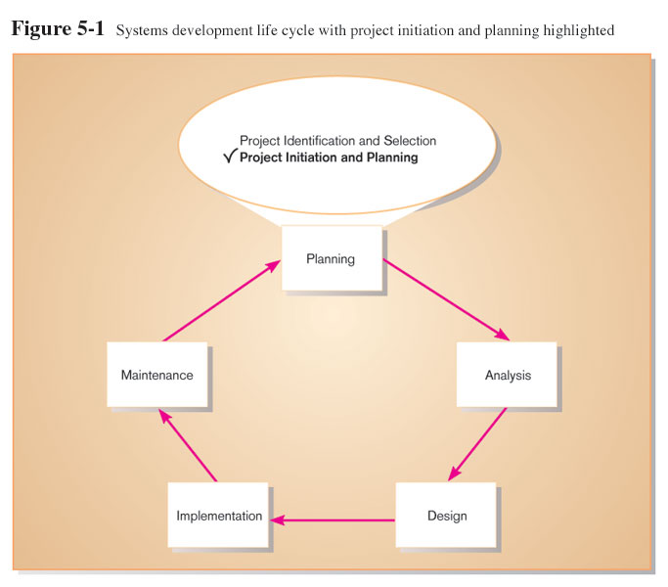
The Process of Initiating and Planning IS Development Projects

Slide 6
The Process of Initiating and Planning IS Development Projects
Project initiation focuses on activities designed to assist in organizing a team to conduct project planning.
Establishing the Project Initiation Team.
Establishing a Relationship with the Customer

Slide 7
Initiating and Planning System Development Projects
Elements of Project Initiation
Establishment of project team
Development of relationship with customer
Establishing the project Initiation Plan
Establishment of Management Procedures
Establishment of Project Workbook and Project Management Environment
Develop the project charter
5.7

Slide 8
The Process of Initiating and Planning IS Development Projects
The key activity of project initiation is the development of the project charter.
A short document that is prepared for both internal and external stakeholders.
Provides a high-level overview of the project.
Useful communication tool that helps to assure that the organizations and other stakeholders understand the initiation of a project

Slide 9
The Process of Initiating and Planning IS Development Projects
A project charter typically contains:
Project title and date of authorization
Project manager name and contact information
Customer name and contact information
Projected start and completion dates

Slide 10
The Process of Initiating and Planning IS Development Projects
Key stakeholders, project role, and responsibilities
Project objectives and description
Key assumptions or approach
Signature section for key stakeholders

Slide 11
The Process of Initiating and Planning IS Development Projects
The key activity of project planning is the process of defining clear, discrete activities and the work needed to complete each activity within a single project.
The objective of the project planning process is the development of a Baseline Project Plan (BPP) and the Project Scope Statement (PSS)

Slide 12
Project Planning
Is the process of defining clear, discrete activities and the work needed to complete each activity, the elements are:
- describe the project scope, alternative, and feasibility. - Divide project into manageable tasks. - Estimate resources, and create resource plan. - Developing a preliminary schedule. - Developing a communication plan. - Determining project standards and procedures. - Identifying and assessing risks. - Creating a preliminary budget. - Developing a Statement Of Work. - Setting a Baseline Project Plan.

Slide 13
Initiating and Planning System Development Projects
Major Deliverables and Outcomes of the plan:
Business Case
Justification for an information system.
Presented in terms of the tangible and intangible economic benefits and costs.
The technical and organizational feasibility of the proposed system
Project Scope Statement (PSS)
A document prepared for the customer.
Describes what the project will deliver.
Outlines at a high level all work required to complete the project. \
Baseline Project Plan (BPP), contains the best estimates of :
A major outcome and deliverable from the PIP phase.
Contains the best estimate of a project’s scope, benefits, costs, risks, and resource requirements.
Statement of Work (SOW)
Describes deliverables
Outlines work needed to be performed
5.13

Slide 14
Assessing Project Feasibility
Six Categories of feasibility:
Economic
Technical
Operational
Schedule
Legal and contractual
Political
5.14

Slide 15
Assessing Economic Feasibility
A process of identifying the financial benefits and costs associated with a development project.
Often referred to as cost-benefit analysis.
Project is reviewed after each SDLC phase in order to decide whether to continue, redirect, or kill a project.
Determine Benefits
Tangible Benefits
Refer to items that Can be measured easily
Examples
Cost reduction and avoidance
Error reduction
Increased flexibility
Increased speed of activity
Improved management planning and control
Opening new markets and increasing sales opportunities
5.15

Slide 16
Assessing Economic Feasibility
Intangible Benefits
are benefits derived from the creation of an information system that cannot be easily measured in dollars or with certainty. Cannot be measured easily
Examples
Increased employee morale
Competitive necessity
More timely information
Promotion of organizational learning and understanding
Determine Costs
Tangible Costs
a cost associated with an information system that can be measured in dollars and with certainty.
IS development tangible costs include:
Hardware costs,
Labor costs, or
Operational costs including employee training and building renovations.
5.16

Slide 17
Assessing Economic Feasibility
Determine Costs (Continued)
Intangible Costs
a cost associated with an information system that cannot be easily measured in terms of dollars or with certainty.
Intangible costs can include:
Loss of customer goodwill,
Employee morale, or
Operational inefficiency.
5.17

Slide 18
Assessing Economic Feasibility
One-Time Costs
Associated with project startup, initiation and development
Includes
System Development
New hardware and software purchases
User training
Site preparation
Data or system conversion
5.18

Slide 19
Assessing Economic Feasibility
Recurring Costs
a cost resulting from the ongoing evolution and use of a system.
Examples of these costs include:
Application software maintenance,
Incremental data storage expenses,
Incremental communications,
New software and hardware leases, and
Supplies and other expenses (i.e. paper, forms, data center personnel).
5.19

Slide 20
Determining Project Costs
Both one-time and recurring costs can consist of items that are fixed or variable in nature.
Fixed costs are billed or incurred at a regular interval and usually at a fixed rate.
Variable costs are items that vary in relation to usage

Slide 21
Determining Project Costs
Procurement
Consulting, equipment, site preparation, capital, management time
Start-up
Operating systems, communications installation, personnel hiring, organizational disruption
Project-related
Application software, software modification, personnel overhead, training, data analysis, documentation
Operating
System maintenance, rental, asset depreciation, operation and planning

Slide 22
The Time Value of Money
Net Present Value (NPV)
Use discount rate to determine present value of cash outlays and receipts
Return on Investment (ROI)
Ratio of cash receipts to cash outlays
Break-Even Analysis (BEA)
Amount of time required for cumulative cash flow to equal initial and ongoing investment

Slide 23
The Time Value of Money
Time value of money (TVM): the concept that money available today is worth more than the same amount tomorrow.
Discount rate: the rate of return used to compute the present value of future cash flows (the cost of capital).
Present value: the current value of a future cash flow

Slide 24

The Time Value of Money
Net Present Value
PVn = present value of Y dollars n years from now based on a discount rate of i.
NPV = sum of PVs across years.
Calculates time value of money.

Slide 25
Assessing Technical Feasibility
Technical Feasibility, a process of assessing the development organization’s ability to construct a proposed system.
The potential consequences of not assessing and managing risks can include the following:
Failure to attain expected benefits from the project,
Inaccurate project cost estimates,
Inaccurate project duration estimates,
Failure to achieve adequate system performance levels, and
Failure to adequately integrate the new system with existing hardware, software, or organizational procedures.
5.25

Slide 26
Project Risk Factors
Project size
Team size, organizational departments, project duration, programming effort
Project structure
New vs. renovated system, resulting organizational changes, management commitment, user perceptions
Development group
Familiarity with platform, software, development method, application area, development of similar systems
User group
Familiarity with IS development process, application area, use of similar systems

Slide 27
Assessing Technical Feasibility
Risk can be managed on a project by:
Changing the project plan to avoid risky factors,
Assigning project team members to carefully manage the risky aspects,
Setting up monitoring methods to determine whether or not potential risk is, in fact, materializing.

Slide 28
Assessing Technical Feasibility
Four general rules emerged as technical risk assessments:
Larger projects are riskier than smaller projects.
A system in which the requirements are easily obtained and highly structured will be less risky than one in which requirements are messy, ill structured, ill defined, or subject to the judgment of an individual.
The development of a system employing commonly used or standard technology will be less risky than one employing novel or nonstandard technology.
A project is less risky when the user group is familiar with the familiar with the systems development process and application area than if unfamiliar.

Slide 29
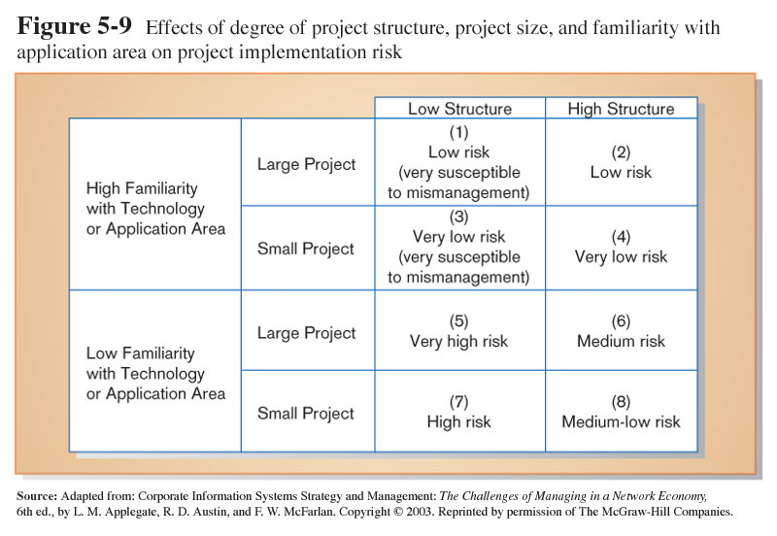
Assessing Technical Feasibility

Slide 30
Assessing Other Project Feasibility Concerns
Operational
Does the proposed system solve problems or take advantage of opportunities?
Scheduling
Can the project time frame and completion dates meet organizational deadlines?
Legal and Contractual
What are legal and contractual ramifications of the proposed system development project?
Political
How do key stakeholders view the proposed system?
5.30

Slide 31
Building the Baseline Project Plan
Baseline Project Plan (BPP) is a document intended primarily to guide the development team.
Sections:
Introduction
System description
Feasibility assessment
Management issues
5.31

Slide 32
Building the Baseline Project Plan
Project Scope statement is part of the BPP introduction.
Sections:
Problem statement
Project objectives
Project description
Business benefits
Deliverables
Expected duration
5.32

Slide 33
Factors in Determining Scope
Organizational units affected by new system
Current systems that will interact with or change because of new system
People who are affected by new system
Range of potential system capabilities
5.33

Slide 34
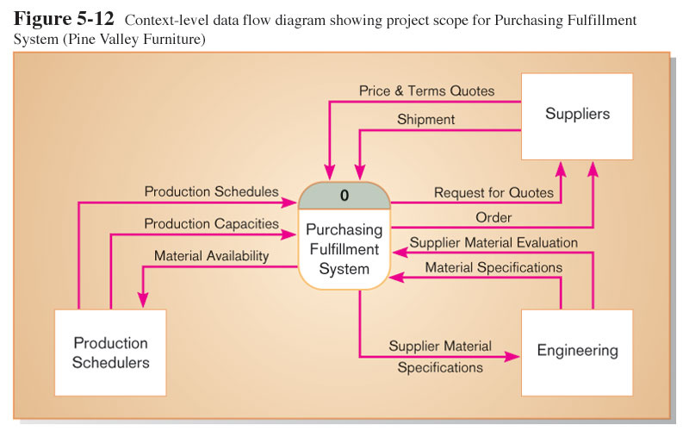
Diagram Depiction of Project Scope

Slide 35
Building the Baseline Project Plan (CONT..)
System description section outlines possible alternative solutions.
Feasibility assessment section outlines issues related to project costs and benefits, technical difficulties, and other such concerns.
Management issues section outlines a number of managerial concerns related to the project
5.35

Slide 36
Reviewing the Baseline Project Plan
Structured Walkthroughs: a peer-group review of any product created during the system development process
Roles: coordinator, presenter, user, secretary, standard-bearer, maintenance oracle
Can be applied to BPP, system specifications, logical and physical designs, program code, test procedures, manuals and documentation
Objectives
Assure conformity to organizational standards
All parties agree to continue with project
5.36

